Slide 1




June 2024
Birth Rate Trends
A Global Population Shift
Presented by
Karen Delapaz
Notes:
Hello,
Today I will be presenting on birth rate trends, numerous policies that impact birth rates across the globe, and the misconception regarding the potential for endless expansion of human population

Slide 2

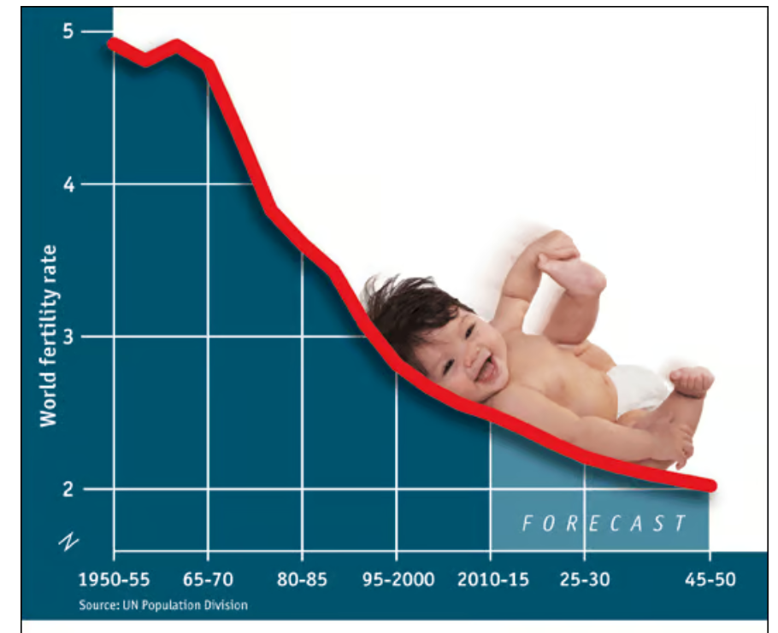
Population Growth Rate and Why it Matters
The POPULATION GROWTH RATE compares the average annual percent change in populations, resulting from a surplus (or deficit) of births over deaths and the balance of migrants entering and leaving a country. The rate may be positive or negative
CRUDE BIRTH RATE - Crude birth rate indicates the number of live births occurring during the year, per 1,000 population estimated at midyear.
FERTILITY RATE - Number of live births per 1,000 females of childbearing age (between the ages of 15 and 44 years).
REPLACEMENT LEVEL FERTILITY is the level of fertility at which a population exactly replaces itself from one generation to the next.
The ideal replacement rate level is 2.1 children per woman
Notes:
First, lets start with defining what is population growth rate and why does it matter
The POPULATION GROWTH RATE compares the average annual percent change in populations, resulting from a surplus (or deficit) of births over deaths and the balance of migrants entering and leaving a country. The rate may be positive or negative
Here we also have the definitions for Crude birth rate and Fertility rate
So why does Population Growth Rate matter, well the short answer is due to the importance of replacement level fertility
Replacement level fertility is the level of fertility at which a population exactly replaces itself from one generation to the next.
replacement level fertility can be taken as requiring an average of 2.1 children per woman. And in countries with high child mortality rates the average number of births need to be higher for that population to reach their ideal replacement levels
Many countries around the world are experiencing worrying declines in birth rates that could have major economic, social and political implications if left unaddressed.

Slide 3

Fertility Rate
• The current birth rate for the World in 2024 is 17.299 births per 1000 people, a 0.94% decline from 2023.
• The birth rate for the World in 2023 was 17.464 births per 1000 people, a 1.15% decline from 2022.
• The birth rate for the World in 2022 was 17.668 births per 1000 people, a 1.15% decline from 2021.
• The birth rate for World in 2021 was 17.873 births per 1000 people, a 1.13% decline from 2020.
Notes:
- Paul Ehrlich’s (Erlick) 1968 published book "The Population Bomb" predicted resource shortages and collapse by 2000
- In 1972 MIT researchers predicted similar outcomes by 2040
(((((ShowGraph)))))
These predictions influenced policies like China's one-child policy in 1979 (click)
In 1970 India Local laws applied penalties for having more than two children.
Recent Studies:
- Club of Rome study state population to peak at 8.6 billion mid-century, then decline by 2 billion
- University of Washington study: suggest population will peak at 9.7 billion by 2064, fall to 8.8 billion by the year 2100
Once again the ideal replacement rate level is 2.1 children per woman
• The current birth rate for World in 2024 is 17.299 births per 1000 people, a 0.94% decline from 2023.

Slide 4

Causes of Population Decline:
- Declining birth rates and fertility rates
- Modernization and urbanization
- Improved child survival rates
- Women's education and career opportunities
- Delayed parenthood
- High cost of raising children
- Changing social norms and expectations
- Access to contraception and other birth control
Notes:
Read all on page

Slide 5

Policies
List of countries that spend the most on family benefits
(includes cash, services and tax breaks for families)
Luxembourg
Sweden
Poland
Belgium
New Zealand
Finland
France
Norway
Australia
Denmark
Germany
Hungary
Estonia
Iceland
United Kingdom
Parents in Sweden (including LGBTQ+, adoptive and single parents) are legally entitled to a total of 480 days off work
Since August 1, 2016, the child support allowance for residents and non-residents in Luxembourg is 285.41 euros per month per child
Iceland’s current policy Payment of child benefits begins one year after the child is born or moves to Iceland. They are paid until the child reaches 18 years of age.
In Germany, all families receive child benefits regardless of their income. It is generally paid for all children up to the age of 18.
In 2019 Hungary introduced a loan of around $30,000 to newlyweds. If they have three children, the loan is forgiven.
In 2010, Russia began offering a one-time sum to families with more than two kids
Notes:
Countries response to the decline in birth rates has been mixed with some governments having implemented various policies like enhanced parental leave, childcare subsidies, cash and tax deductions , while other countries have restrictions on abortion access and contraception in an attempt to increase fertility rates.
Here we have some of the polices that were instituted after their individual population plumet
These are Pro family polices

Slide 6
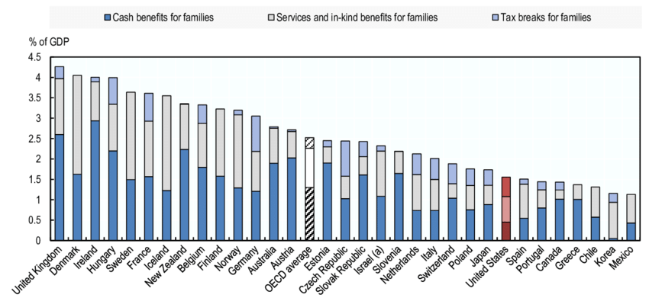

Notes:
This graph shows the countries that are spending more per their GDP

Slide 7
Notes:
Many European countries that experienced plummeting fertility in the 1980s and ’90s have adopted pro-family policies
United kingdom experience a drop in the 1980s and ’90s which cost them to adopted pro-family policies
Norway also increase their pro_family polices since mid 1960 birth decline. Norwegian fertility levels never fell below 1.6, today their fertility level is 1.86
Italy __________( we see an increase in population in the 2000s the increase in population is due to immigrants. In Italy, 12 people now die for every seven babies born. In April 2021, their goverment established the General Family Allowance— with the aim of “promoting the birth rate, supporting parenthood and promoting employment, especially for women”
In China__________This drop in population was due to the Great Famine, China shrank by roughly 700,000 people between 1960 and 1961_______ China's one-child policy in 1979 decreased their population and as of 2024 their population growth rate .05%
Sounth Korea growth rate is -.08 _In 1962, South Korea began its national family planning campaign to REDUCE women’s unwanted births through a program of information, By 1970, the Total fertility Rate had fallen to 4.5 South Korean Government Promoted Smaller Families in the 1970s and 1980s .___________ And in 2006-2010 The Saero-Maji (“new beginning”) Plan included provisions to provide a more favorable environment for childbearing in an attempt to increase their population
Like mention in 1970 India’s Local laws started apply penalties for having more than two children. From what I was reading, to be a political leader you can’t have more that 2 children in many local towns/Cities this is not a policy but a culture change
USA _______Currently we have a population growth of .30 we can see how immigration has a close correlation with population growth recent we have seen changes in polices around fertility, with contraception and abortion rights.
Nigeria has high birth rates but also High infant mortality
183 out of 195 countries already are below replacement levels
do not click on congo

Slide 8

What is Influencing Population Size?
- Birth Rates: Influenced by cultural, social, economic, and political factors.
- Death Rates: Affected by healthcare quality, living conditions, and public health initiatives.
- Migration: Both immigration and emigration impact population size and composition.
- Economic Conditions: Prosperity can lead to lower birth rates, while economic challenges may lead to higher mortality or migration.
- Government Policies: Policies like China's former one-child policy or pro-natalist policies in some European countries directly influence population trends.
- Cultural and Religious Beliefs: These can significantly affect birth rates and family planning practices.
Notes:
What is Influencing Population Size?
Birth Rates: Influenced by cultural, social, economic, and political factors.
- Death Rates: Affected by healthcare quality, living conditions, and public health initiatives.
- Migration: Both immigration and emigration impact population size and composition.
- Economic Conditions: Prosperity can lead to lower birth rates, while economic challenges may lead to higher mortality or migration.
- Government Policies: Policies like China's former one-child policy or pro-natalist policies in some European countries directly influence population trends.
- Cultural and Religious Beliefs: These can significantly affect birth rates and family planning practices.
Another thing that I looked into was births by age of the mother, it is prejected that women are having children at later in age as well.

Slide 9

Effects of a Declining Population
- Economic Impact:
*Labor Force: Age structure affects the size and productivity of the labor force.
*Dependency Ratios: High dependency ratios (more dependents per working-age person) can strain public resources.
* Economic Growth: Age structure influences savings rates, investment, and economic growth.
- Social Impact:
* Healthcare and Social Services: Aging populations increase demand for healthcare and social services.
*Education: Youthful populations require investment in education and training.
*Social Security Systems: Pension systems and social security can be stressed by demographic imbalances.
Notes:
How does population age structure impact economic and social factors?
Having an older generation living longer we need a growing generation behind them to continue a countries economic prosperity

Slide 10

Conclusion
Notes:
Countries, have come to realize that no single solution is likely to achieve success.
Despite policies not being the sole factor that can control birth rates policies are a lever of influence that we can utilize to ensure we have a healthy growing population, At a healthy level, to ensure a healthy/stable population future generations.

Slide 11
The end
Any questions?
"We do not inherit the Earth from our ancestors; we borrow it from our children." – Native American Proverb

Slide 12
Citations
El Issa , E. (2024, February 29). 2024 cost of Raising Children Report. NerdWallet. https://www.nerdwallet.com/article/finance/2024-cost-of-raising-children-report
North, A. (2023, November 27). You can’t even pay people to have more kids. Vox. https://www.vox.com/23971366/declining-birth-rate-fertility-babies-children
Haub, C. (2010, March). Did South Korea’s population policy work too well? PRB. https://www.prb.org/resources/did-south-koreas-population-policy-work-too-well/
United Nations. (n.d.). World population prospects - population division. United Nations. https://population.un.org/wpp/Download/Archive/Standard/
Yang, S., & Shen, D. (2023, October 24). Looking for a date? in Taiwan, the government is here to help. Los Angeles Times. https://www.latimes.com/world-nation/story/2023-10-24/taiwan-government-matchmaker-plummeting-birth-rate
Notes:
El Issa , E. (2024, February 29). 2024 cost of Raising Children Report. NerdWallet. https://www.nerdwallet.com/article/finance/2024-cost-of-raising-children-report
Haub, C. (2010, March). Did South Korea’s population policy work too well? PRB. https://www.prb.org/resources/did-south-koreas-population-policy-work-too-well/
North, A. (2023, November 27). You can’t even pay people to have more kids. Vox. https://www.vox.com/23971366/declining-birth-rate-fertility-babies-children
United Nations. (n.d.). World population prospects - population division. United Nations. https://population.un.org/wpp/Download/Archive/Standard/
Yang, S., & Shen, D. (2023, October 24). Looking for a date? in Taiwan, the government is here to help. Los Angeles Times. https://www.latimes.com/world-nation/story/2023-10-24/taiwan-government-matchmaker-plummeting-birth-rate

